Slide 1
A Look at some Cryogenic Equipment
Tom Peterson, SLAC
USPAS
January, 2017

Slide 2
Outline
Tevatron cold mechanical seals
LHC test stand cold seals
Valves and bayonets
Compressors
Turboexpanders
Feed box fabrication sequence

Slide 3
Tevatron metallic cold seals Thanks to Dave Augustine, Fermilab, for much of this info and history
The Fermilab Tevatron includes about 1200 interconnects (magnet-to-magnet and magnet-to-endbox), each of which includes
An insulating vacuum to beam vacuum seal
A 4.0 K, 2 bar helium to vacuum seal (“single-phase seal”)
A 4.0 K, 1.2 bar helium to vacuum seal (“two-phase seal”)
An 80 K, 3 bar nitrogen to vacuum seal

Slide 4
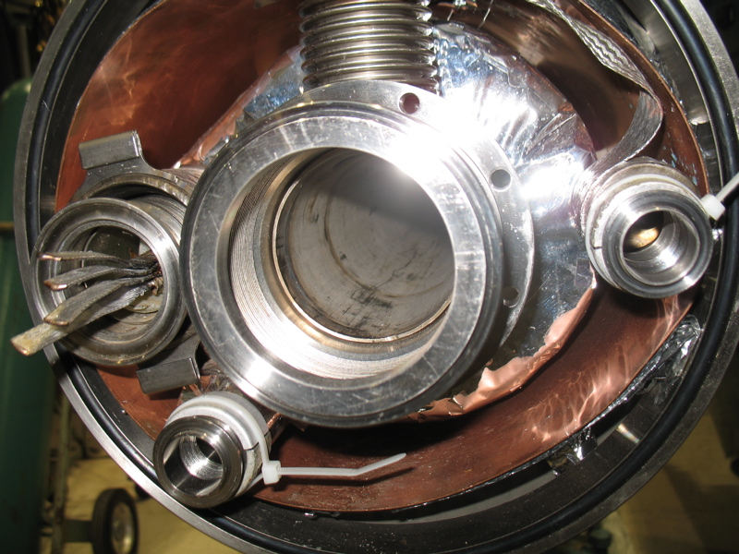
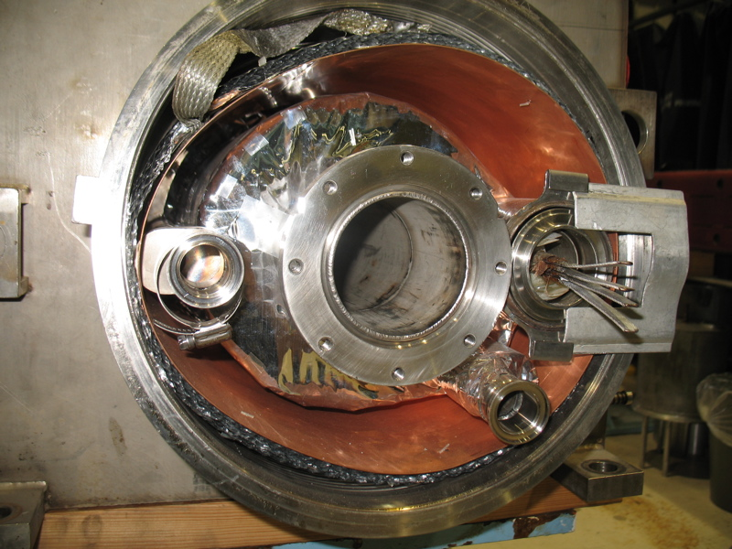
Tevatron magnet interconnect
Beam tube
Nitrogen
2-phase He
Single-phase He

Slide 5
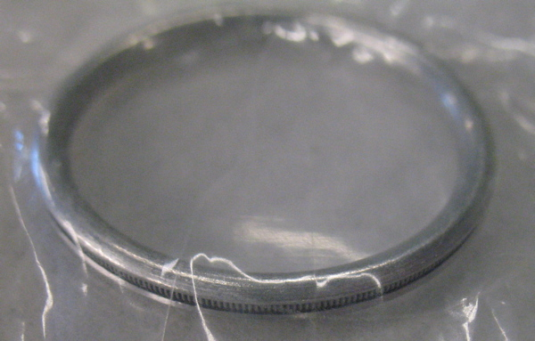
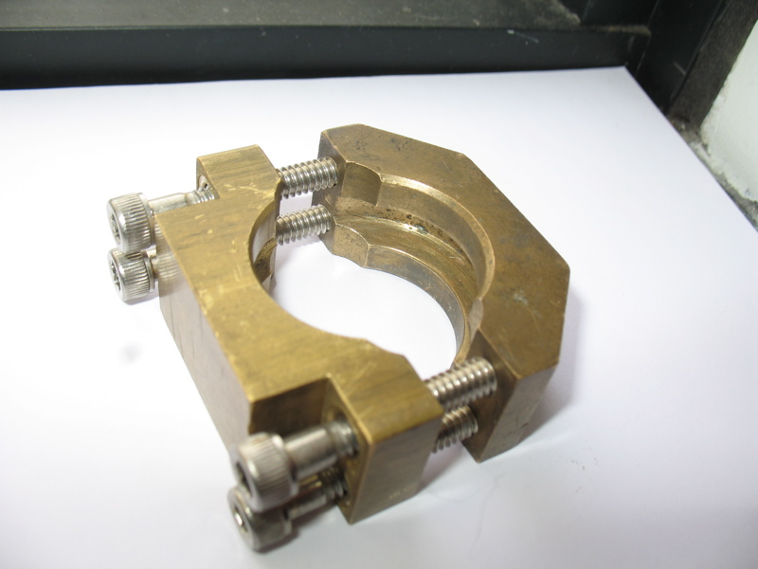
Nitrogen and 2-phase helium
Fermilab-designed brass
wedge clamp -- we like these brass wedge clamps at Fermilab
Aluminum Helicoflex c-seal with internal inconel spring. Surface finish of flange is about 80 micro-inch (2 microns). Seal is designed specifically for this finish.

Slide 6
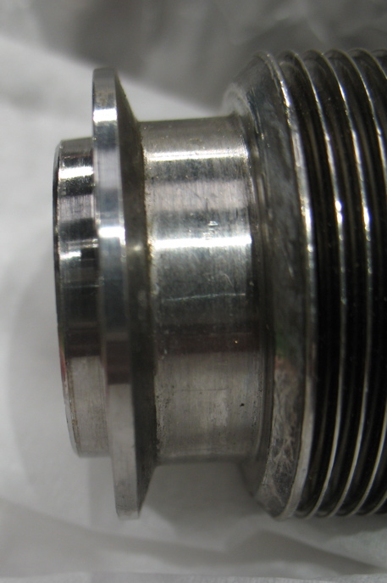
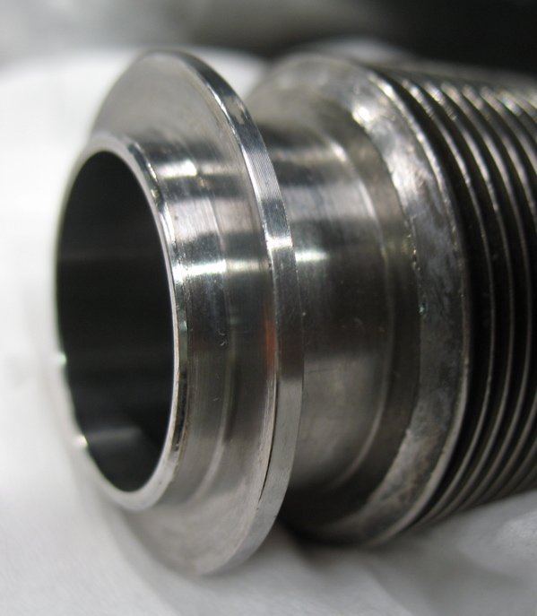
Nitrogen and 2-phase male flange

Slide 7
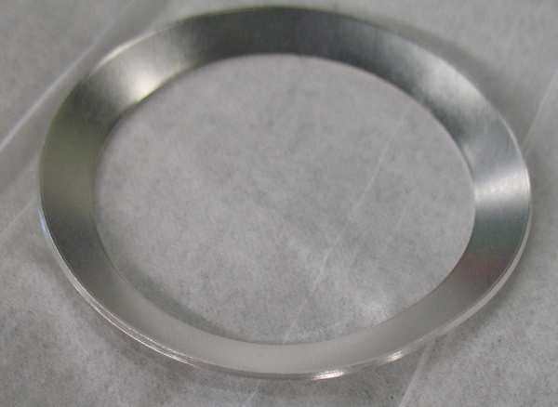
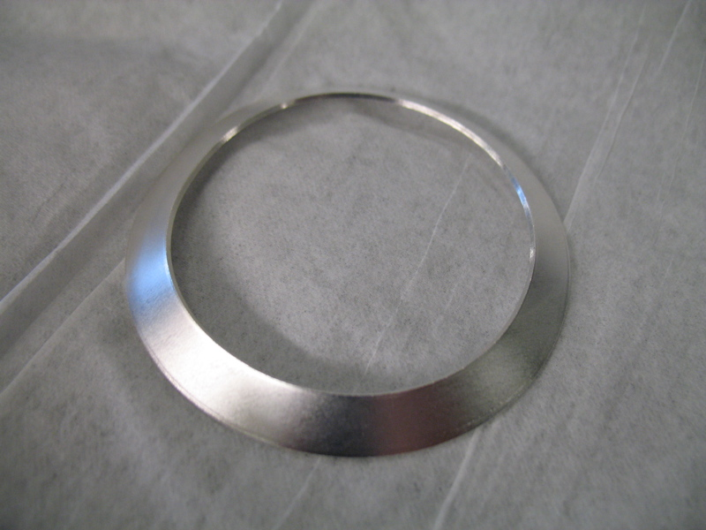
Single-phase helium
Stainless steel, elliptical “Conoseal” from Aeroquip Corp.
Silver coated 0.0005” (13 micron) thick plating. Coated locally.
Indium, copper, and gold plating each failed. (Indium creeps, gold had poor adhesion to the SS.)
Good success with silver, although if the silver corrodes, then it leaks.
Similar 4-bolt Fermilab-designed brass clamp on tapered flanges.

Slide 8
Cold Seals Comments
Indium is popular but not universally endorsed for helium to vacuum metal joints
Indium seals used successfully for SF to vacuum seals at Fermilab’s Magnet Test Facility
Tevatron experience suggested creep and long-term failure
Indium seals used extensively at Jlab for long-term seals (See paper by Benesch and Reece, Advances in Cryo Engineering, Vol. 39A, pg 597)
A very sensitive and successful leak test generally results in a leak tight SF seal. Such a leak check requires a local test fixture around the seal or double-seal.
“Cold leaks” (4.5 K) may be found which are likely just due to greater He density and leak rate cold.
We have not seen “superleaks” (leak tight at 4.5 K but leaking below 2.17 K).

Slide 9
Cold Seal Conclusions?
No consensus on a “formula” for successful cold helium-vacuum seals at Fermilab. (I hoped to provide one from Fermilab’s extensive experience with cold mechanical seals.)
Our experience for magnet tests concurs with H. Ishimaru and H. Yoshiki, KEK (Cryogenics, Vol 31) in that uncoated aluminum seals on stainless flanges closed with chain clamps tended to leak
Hence use of indium ribbon on those seals
But note Tevatron use of aluminum seals on 2-phase helium line.
Indium creep? Yes for conoseal coatings, no for Jlab indium wire seals
Subtle manufacturing and metallurgical details, such as rolling direction, alloy, have significant effects

Slide 10
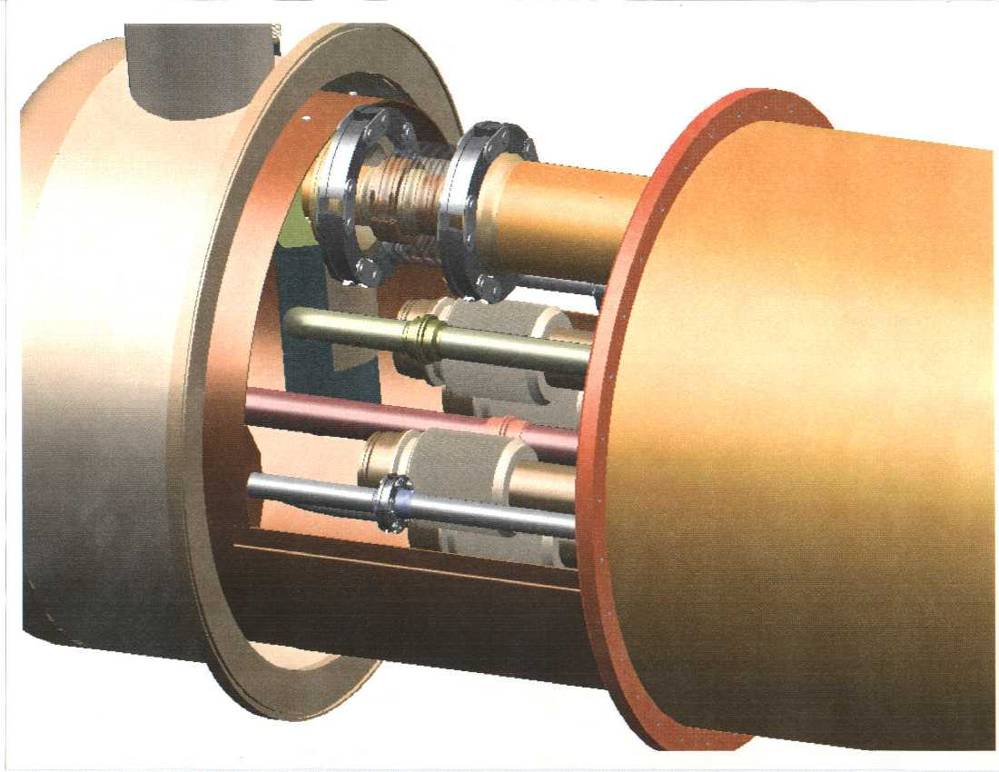

Slide 11
LHC IR Quad Interconnect

Slide 12
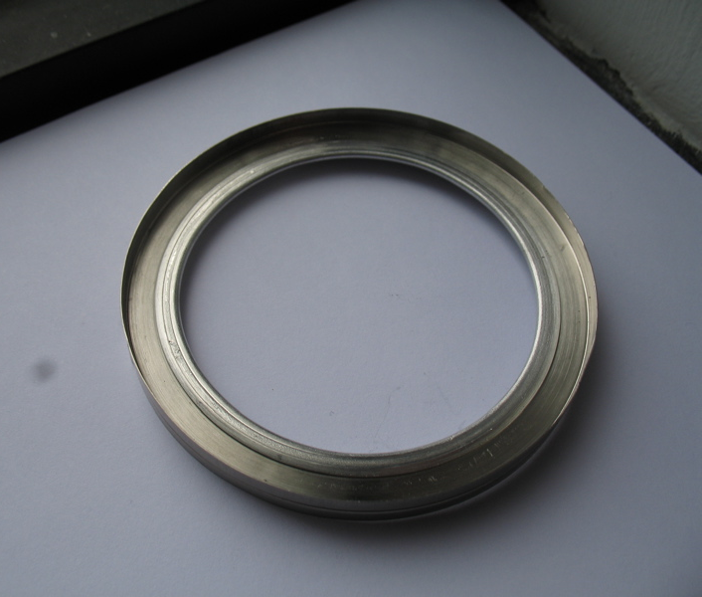
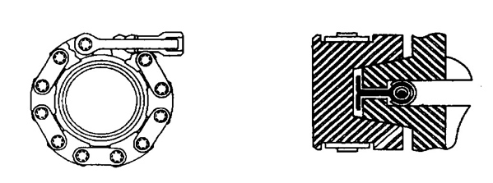
Test stand seals for superfluid to insulating vacuum
2.25 inch (57 mm), up to 6+ inch (150+ mm) ID, with ½ inch (12 mm) wide, 5 mil (0.13 mm) indium ribbon wrapped on
aluminum seal. Chain clamp.
Reference for these seals: “Sealing performance of gaskets
and flanges against superfluid helium,” by H. Ishimaru and
H. Yoshiki, KEK, in Cryogenics, Vol 31, June 1991.

Slide 13
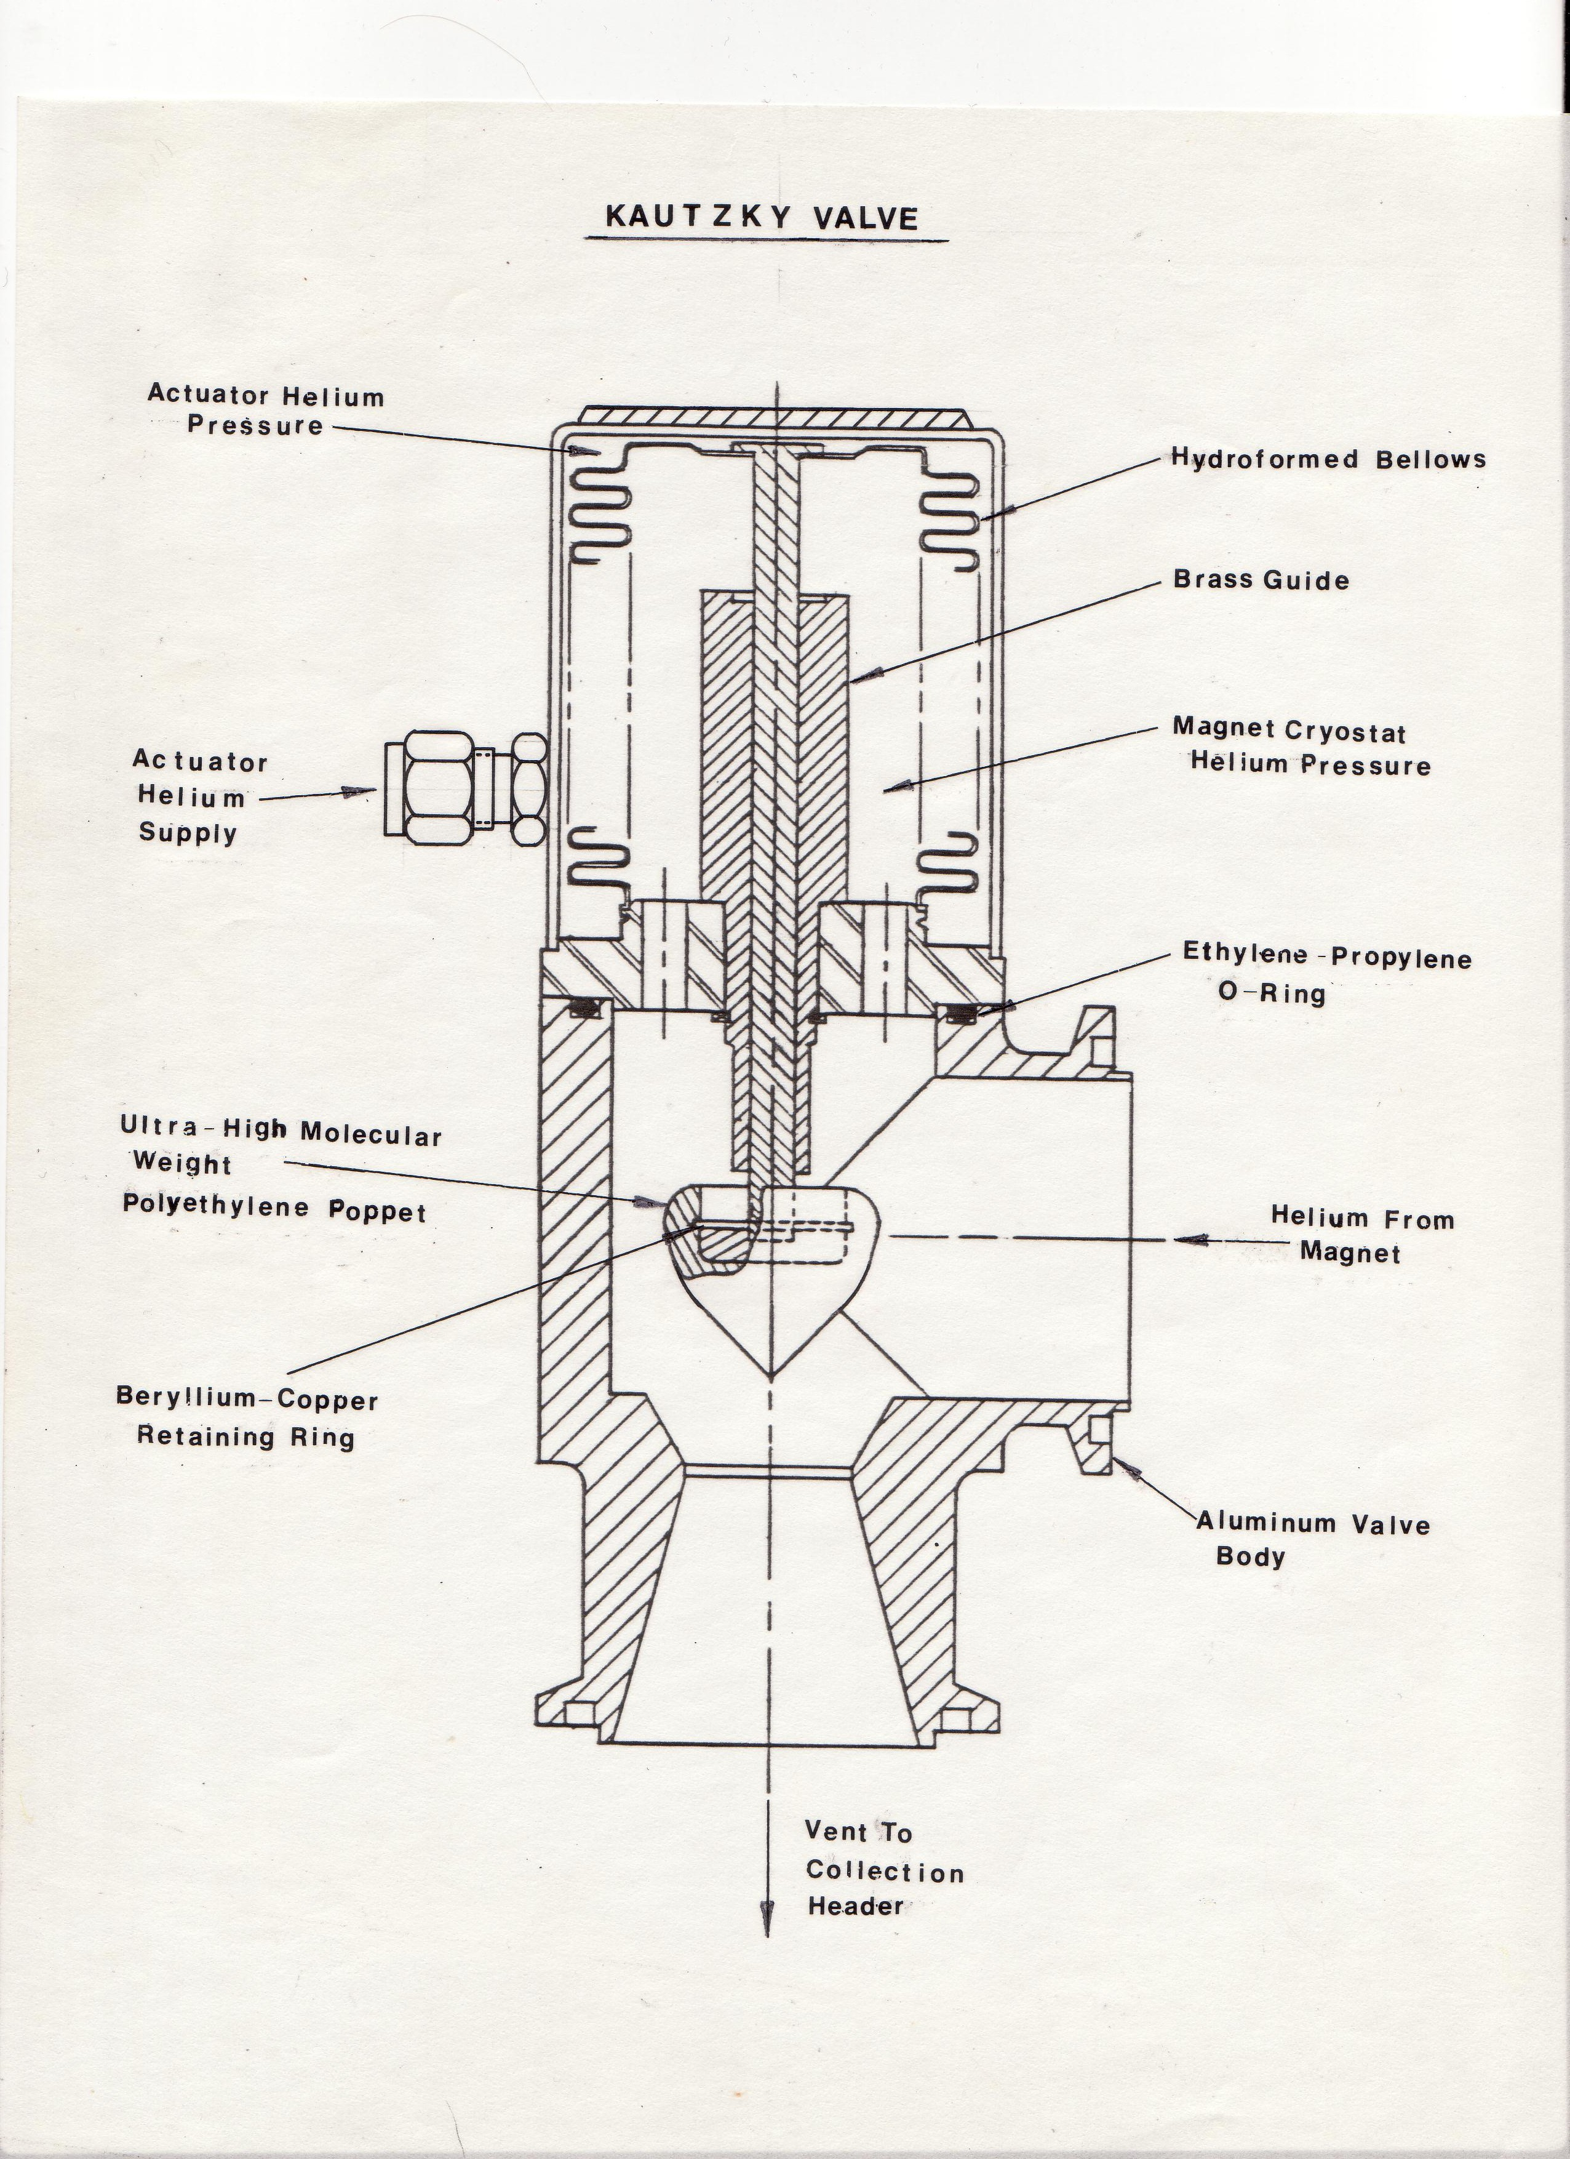
“Kautzky Valve” (concept developed by Hans Kautzky, Fermilab) served as the primary quench vent valve for Tevatron magnets. Valve illustrates the typical cryogenic valve configuration with a poppet in a valve body, stem with actuator (not extended in this case since valve normally warm). Flow would normally but up through the poppet but in some cases including this, may be down over the poppet. The latter case especially for 2 K JT valves, discharge side subatmospheric, so as to place the stem at positive pressure.

Slide 14
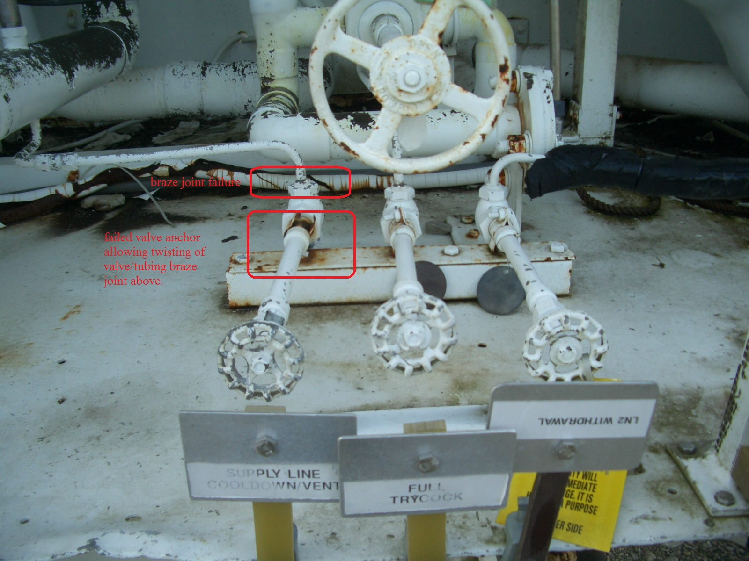
Extended stem hand valves typical of LN2 installation

Slide 15
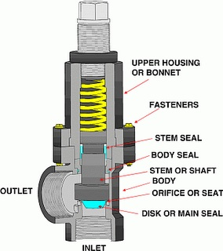
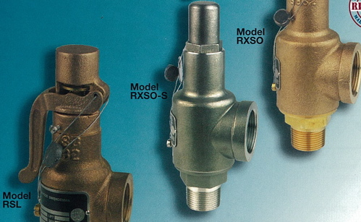
Spring-loaded relief valves

Slide 16
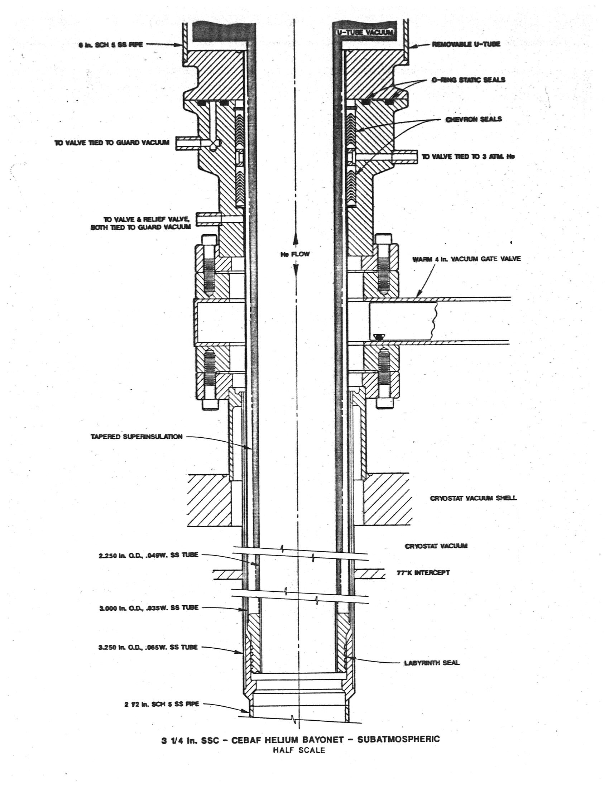
Bayonet – SSC/CEBAF design for subatmospheric operation. Bayonet advantage is a mechanical disconnect with seals at room-temperature. A vacuum-jacketed tube fits into a second vacuum-jacketed tube with the adjacent vacuum jacket walls transitioning to room temperature.

Slide 17
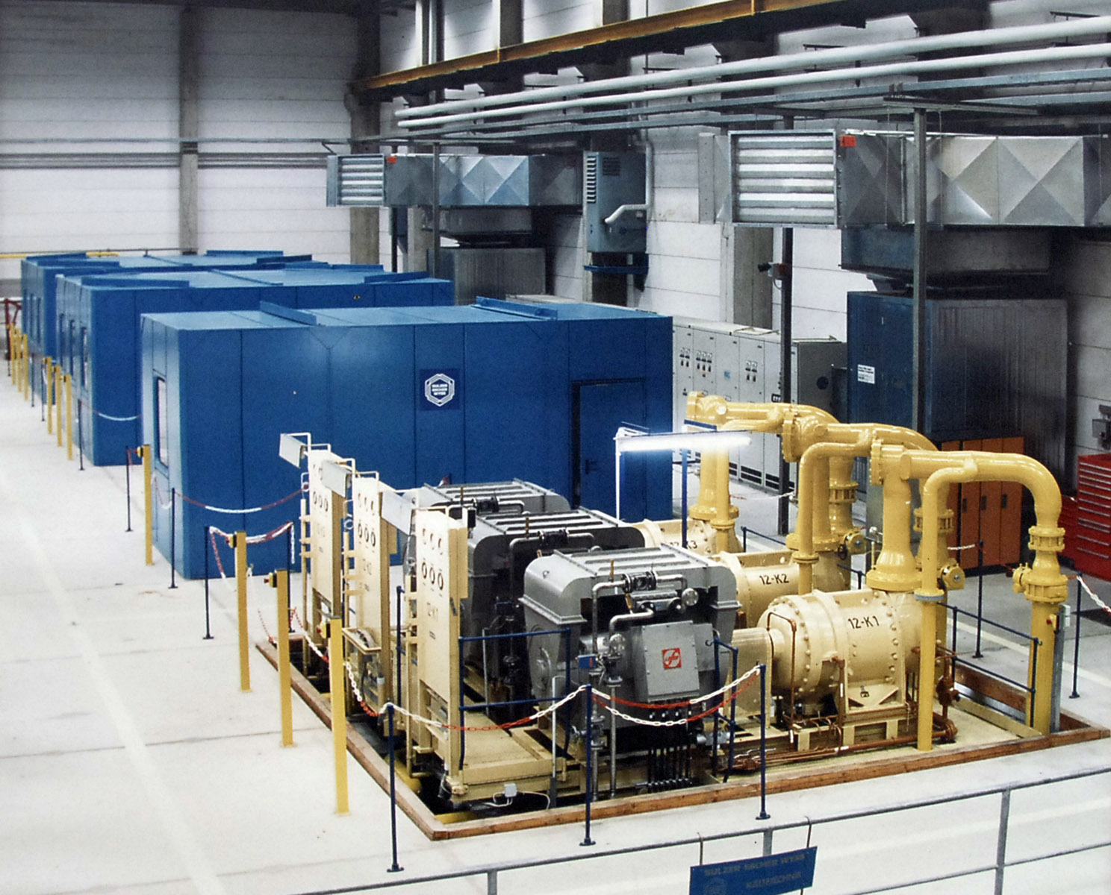
Compressors
Compressor
hall at DESY

Slide 18
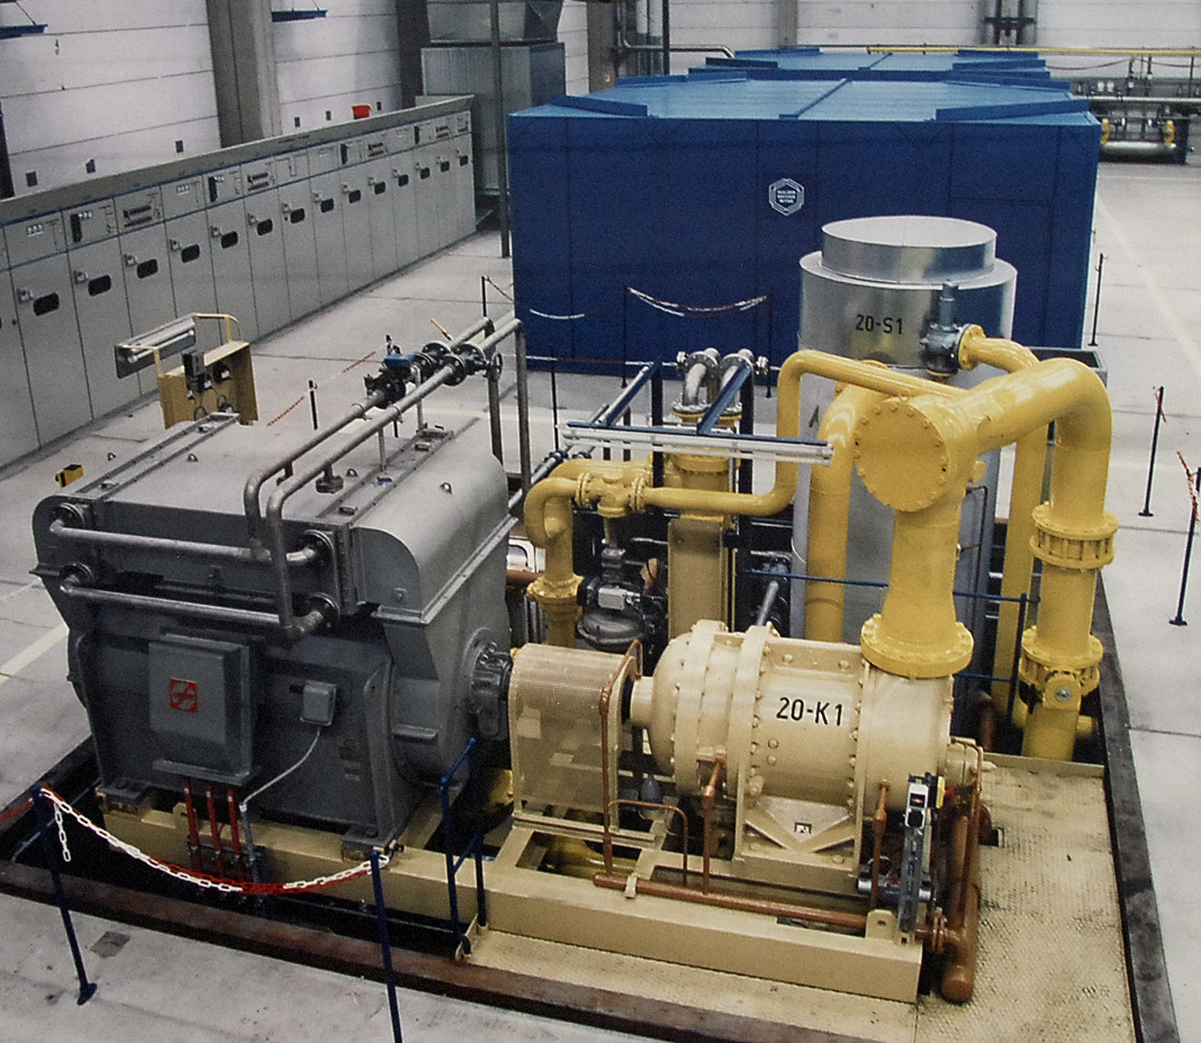

Slide 19
LHC (CERN) compressors

Slide 21
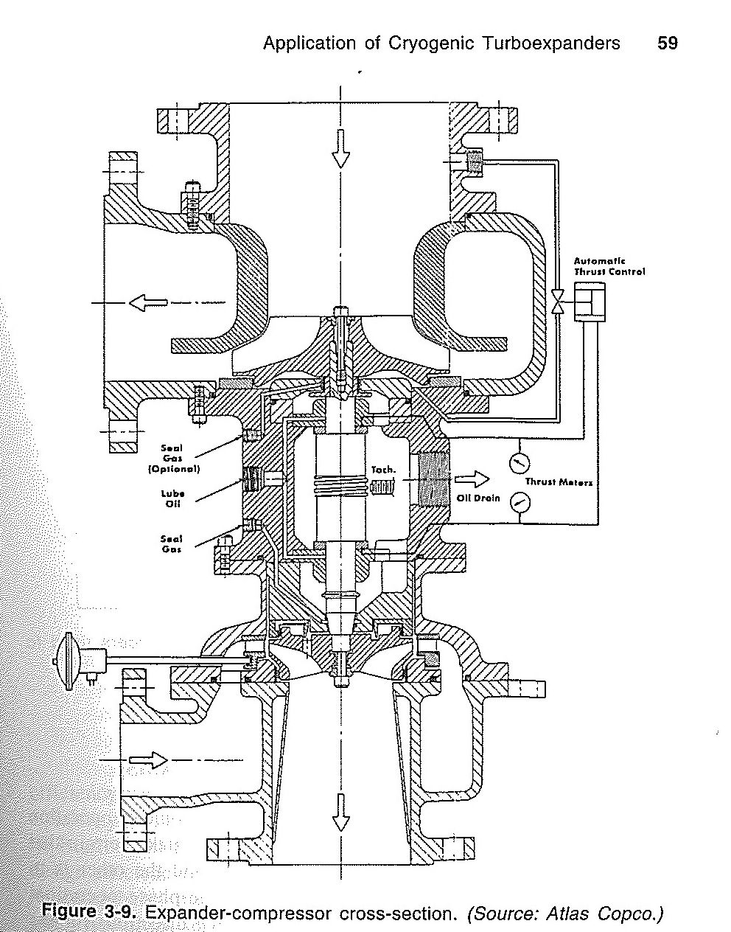
From Heinz P. Bloch,
“Turboexpanders and
Process Applications”
At the bottom is a radial-
inflow turboexpander,
driven by a turbo-
compressor on top

Slide 22
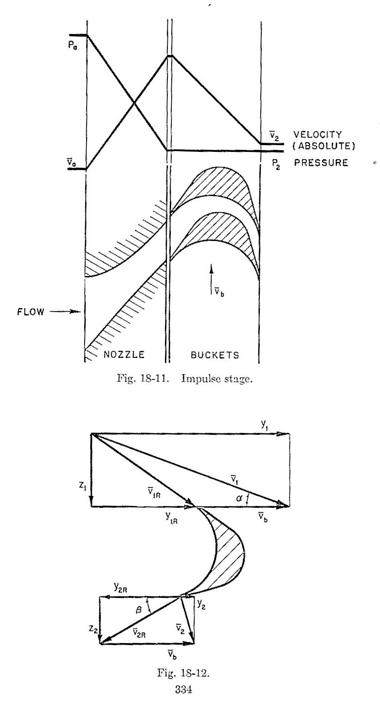
From David A. Mooney,
“Mechanical Engineering
Thermodynamics”
Illustrating how flow is
accelerated through
stationary nozzles
imparting kinetic energy
to turbine blades

Slide 23
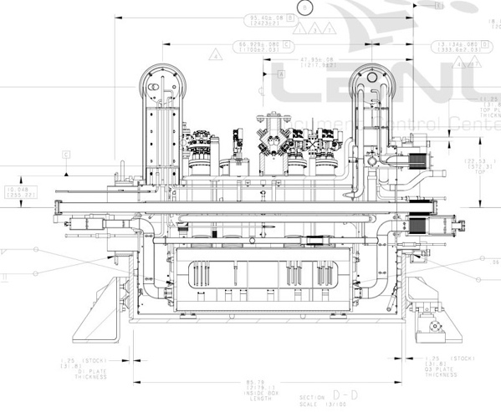
Fabrication of a “feed box”
The following photos illustrate the sequence of major steps in fabrication of a large cryogenic box in industry
A “distribution feed box” or DFBX for the inner triplet magnets in LHC
Eight boxes fabricated at Meyer Tool near Chicago and shipped to CERN

Slide 25
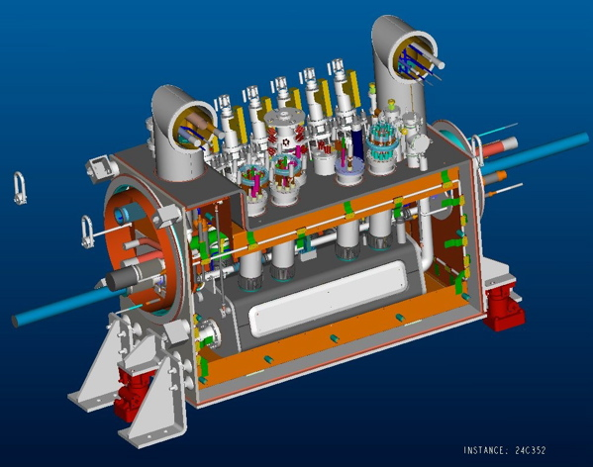

Slide 26
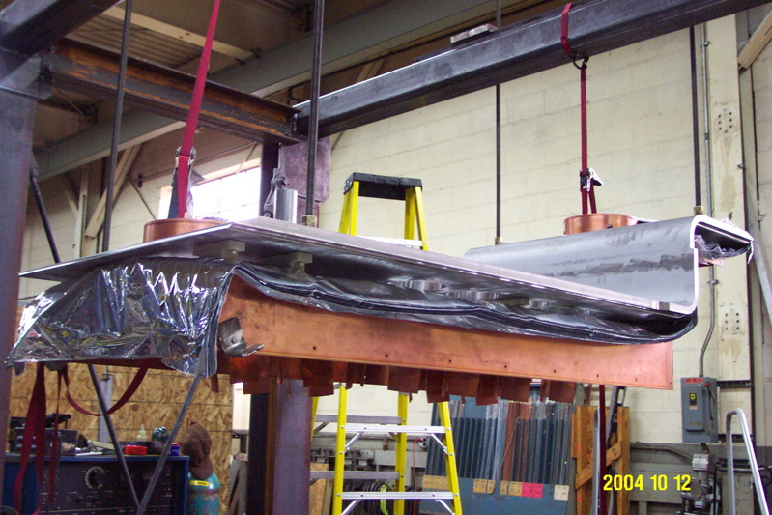
Build from top plate, down

Slide 27
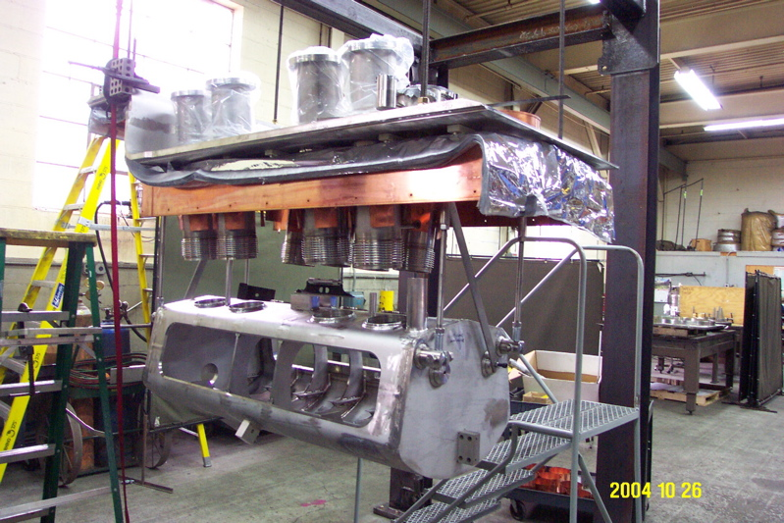
Hang helium vessel

Slide 28
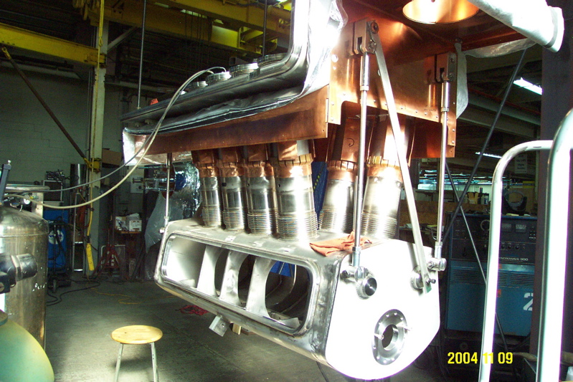
Connect helium vessel

Slide 29
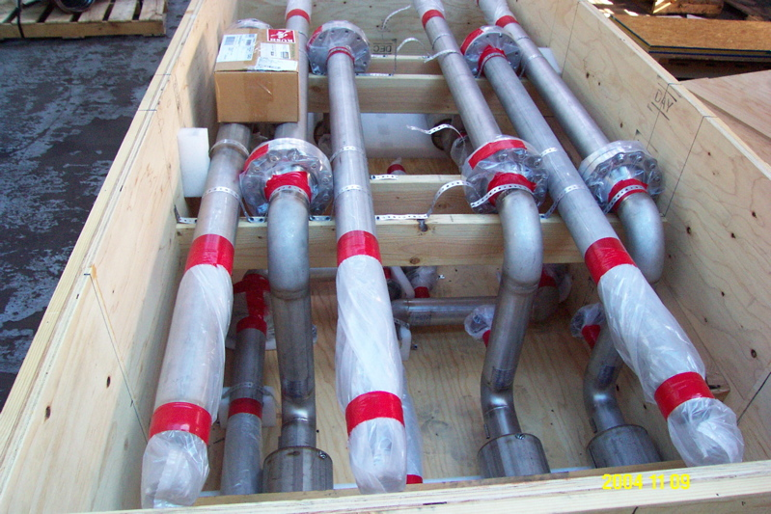
Prefabricated piping (“bus duct”)

Slide 30
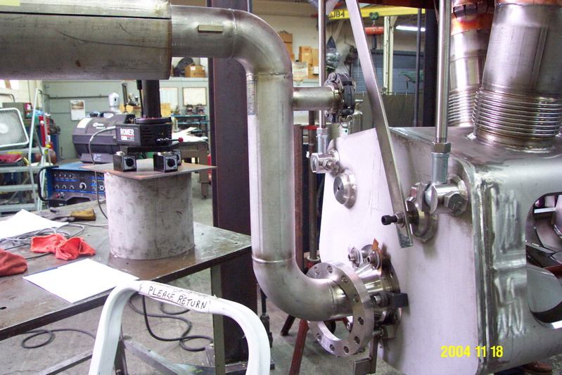
Install bus ducts

Slide 31
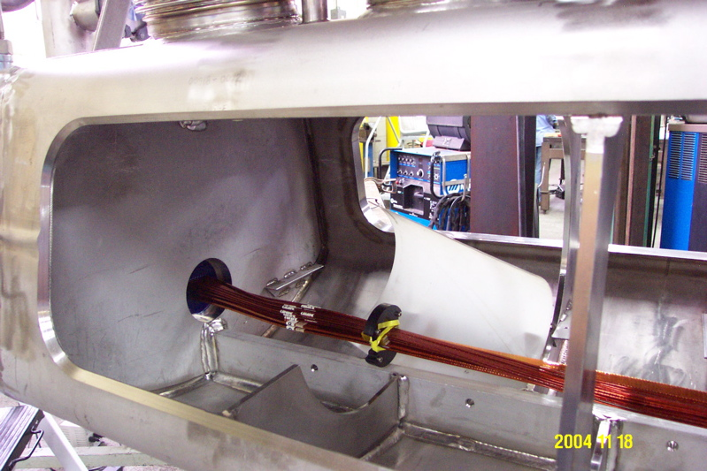
Splice and package internal cables

Slide 32
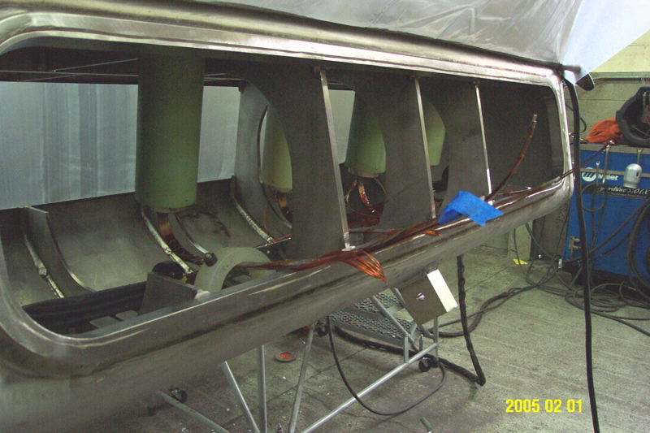
Splice and package internal cables

Slide 33
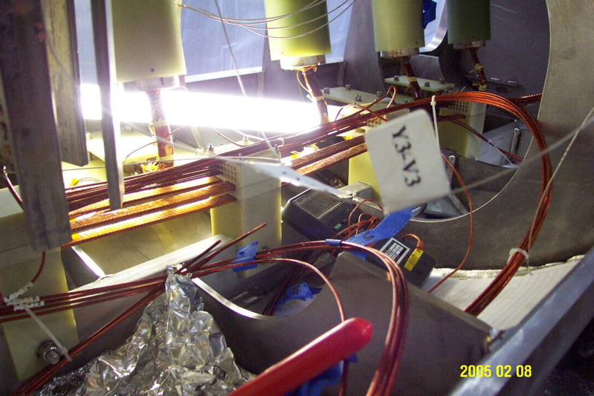
Splice and package internal cables

Slide 34
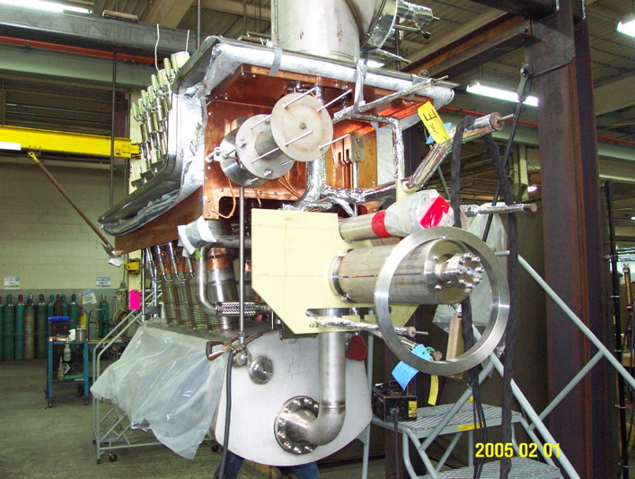
Install more piping

Slide 35
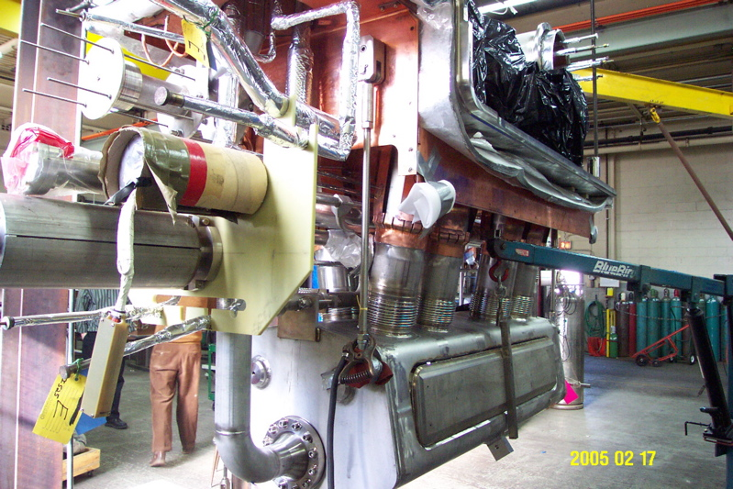
Weld closed helium vessel

Slide 36
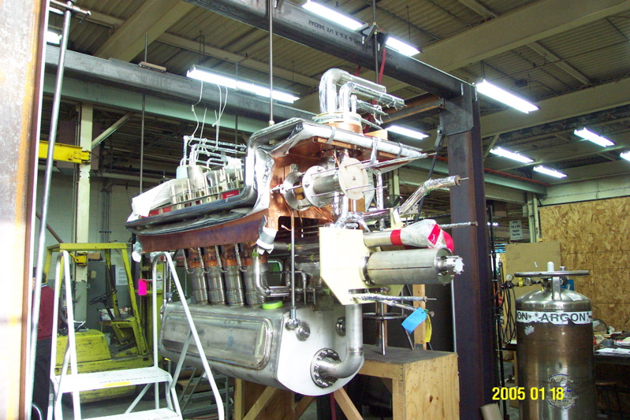
Leak check He vessel

Slide 37
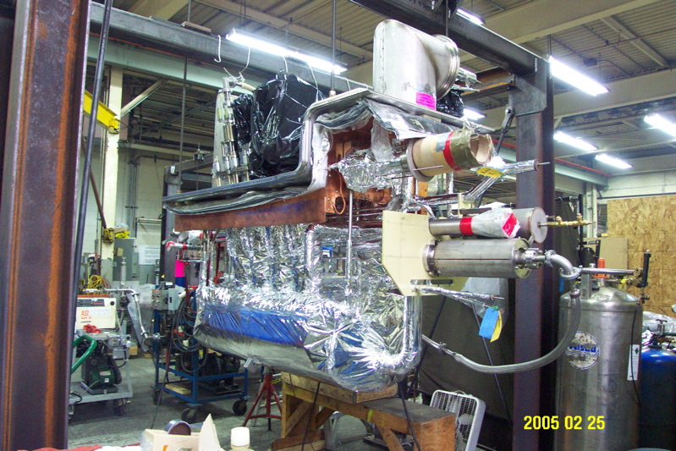
Wrap with MLI

Slide 38
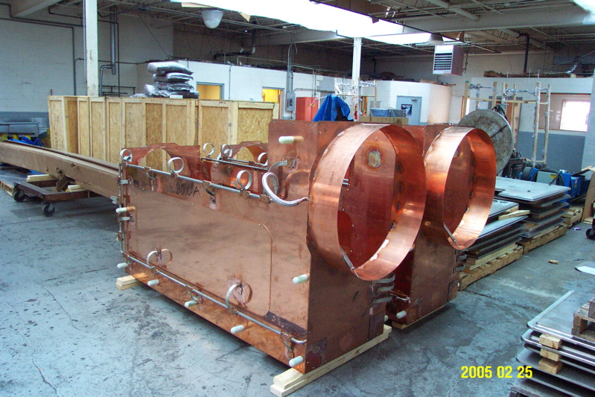
Prefabricated thermal shields

Slide 39
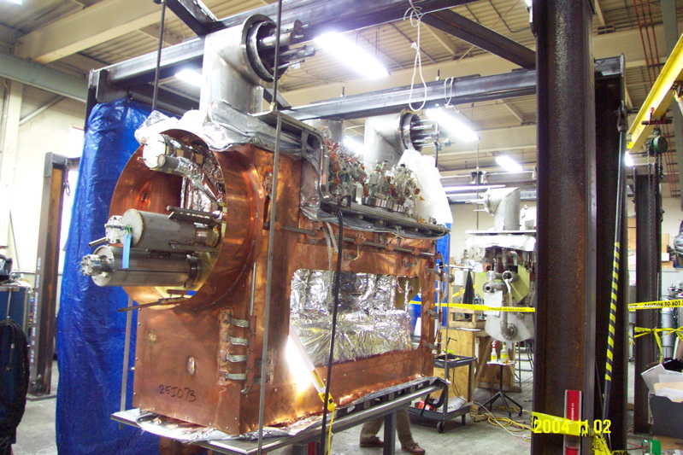
Install thermal shields

Slide 40
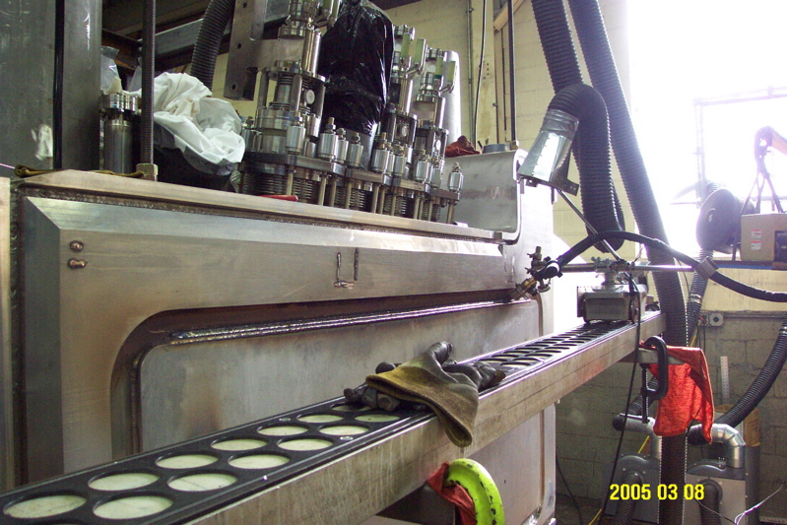
Weld vacuum shell

Slide 41
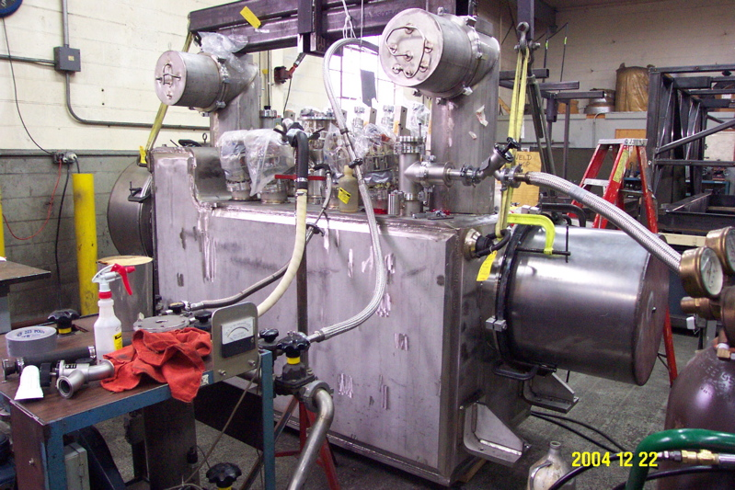
Final leak check and inspection

Slide 42
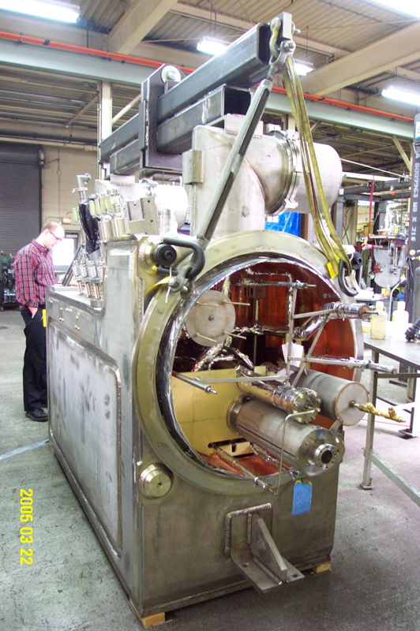
Completed feed box

Slide 43
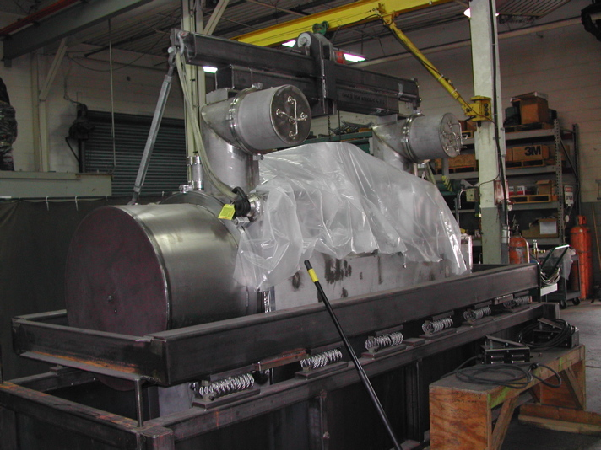
Shock-absorbing shipping frame

Slide 44
SRF Cryomodule Assembly
LCLS-II prototype cryomodule assemblies
Photos from Jefferson Lab and Fermilab

Slide 45
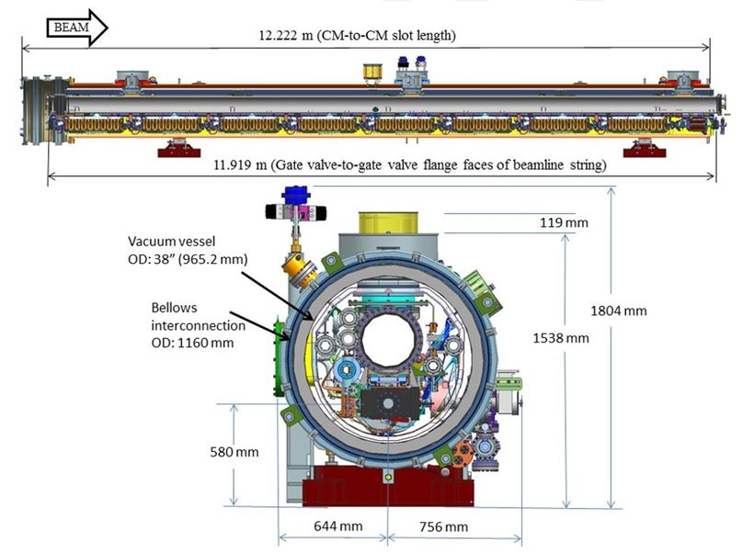
LCLS-II cryomodule assembly CAD model

Slide 46
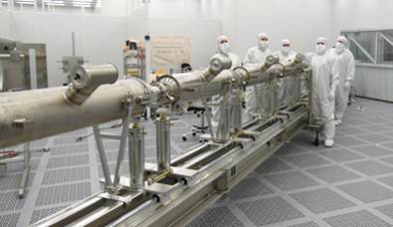
Cavity string – Jlab cleanroom

Slide 47
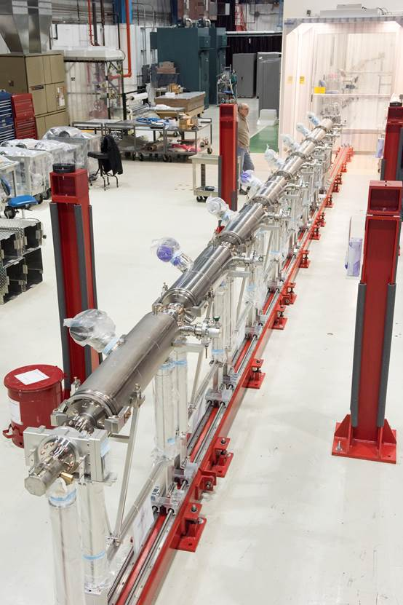
Cavity string out of cleanroom (Fermilab)

Slide 48
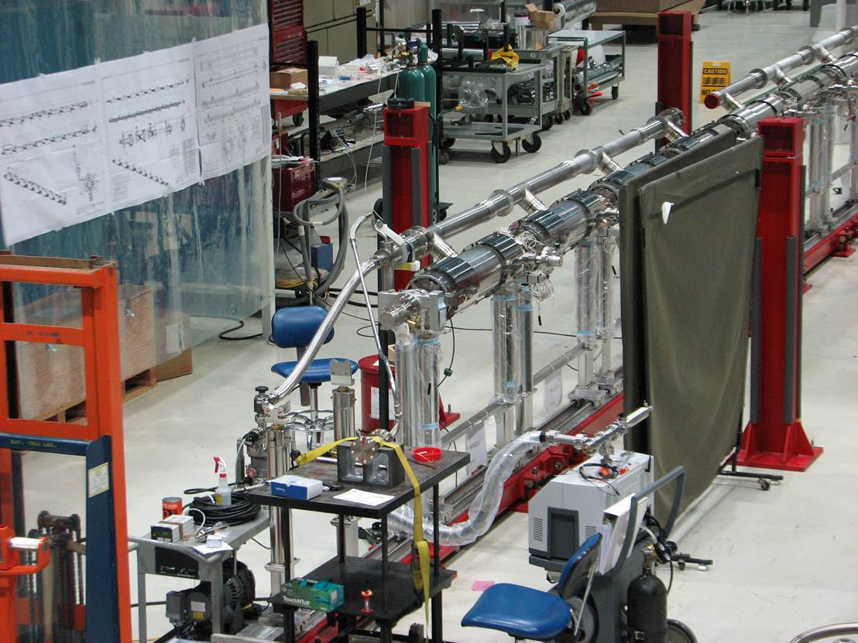
Welding and leak checking cryogenic pipes

Slide 49
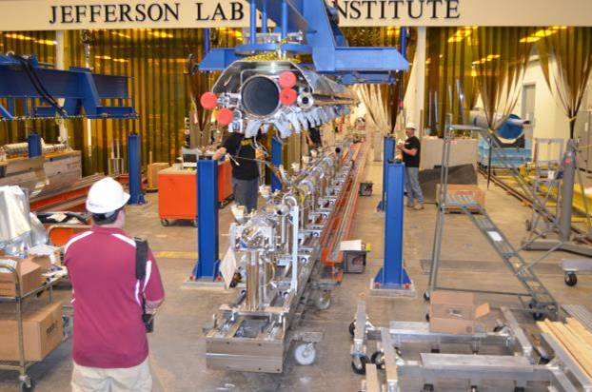
Attaching cavity string to cryogenic structure

Slide 50
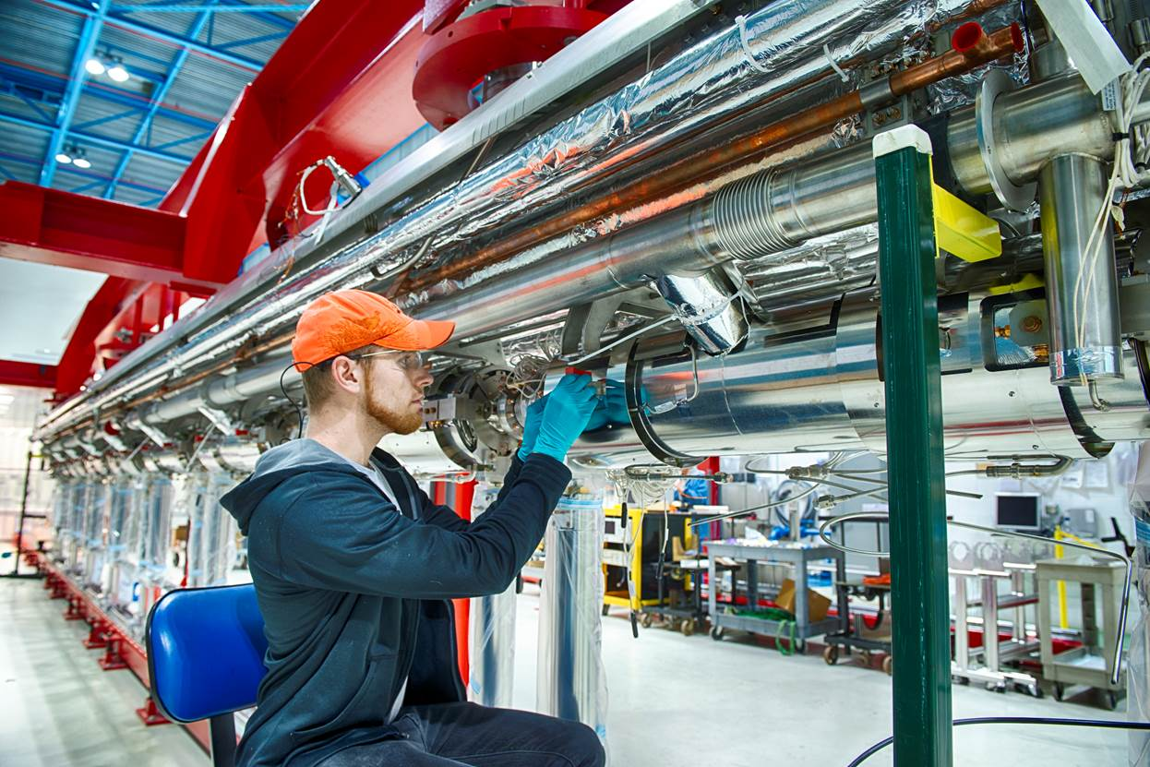
Integration of cavity string with cryogenic pipes and supports

Slide 51
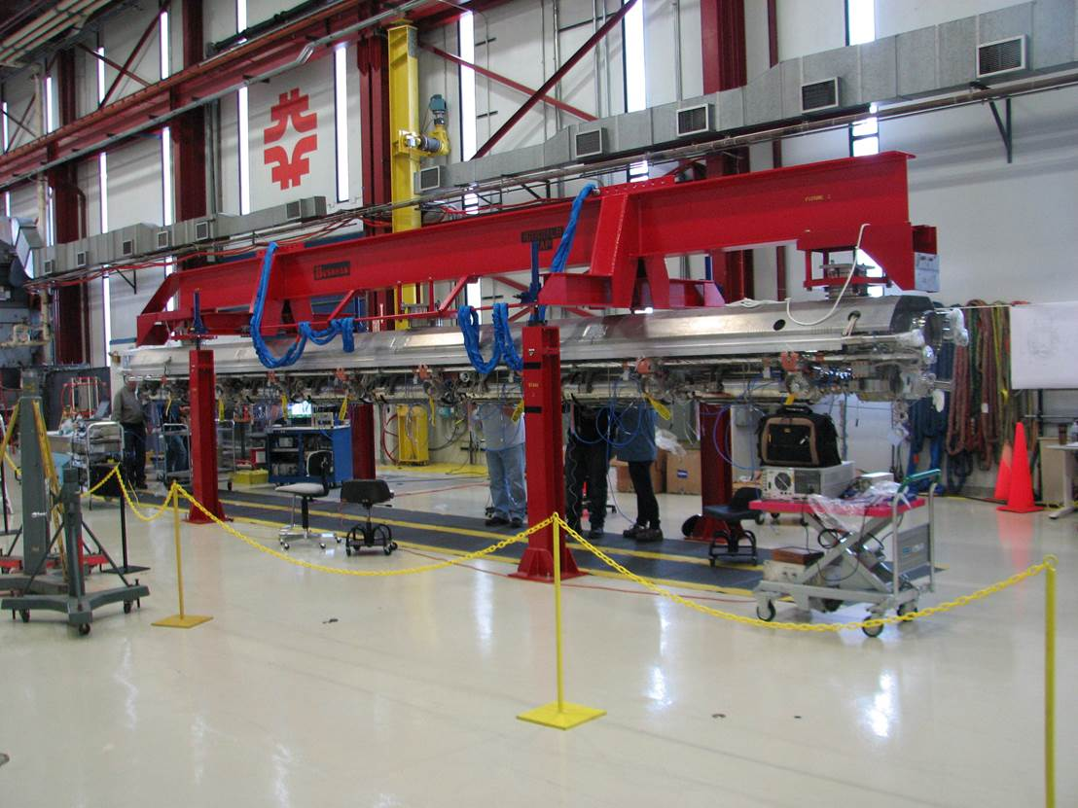
Assembly at alignment and instrumentation station

Slide 52
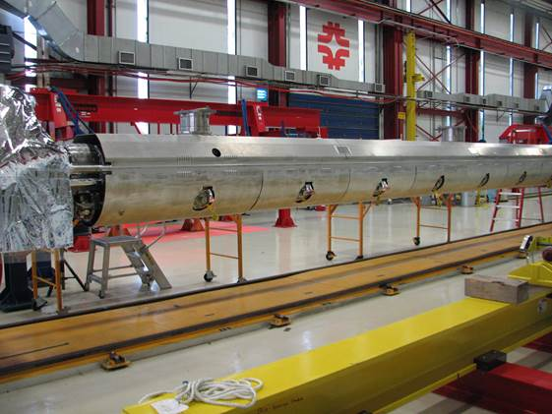
Thermal shield installed

Slide 53
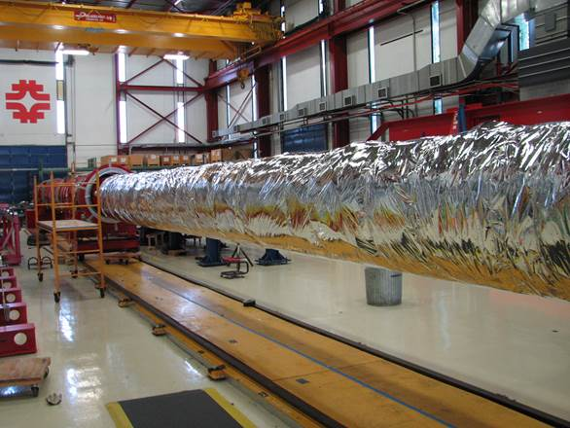
Multilayer insulation wrapped

Slide 54
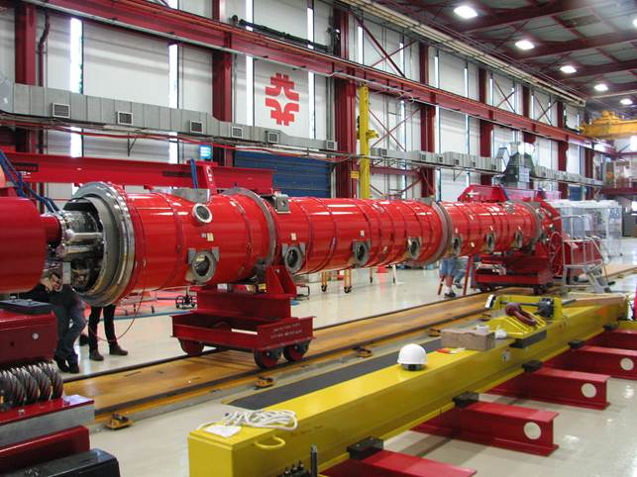
Assembly into vacuum vessel

Slide 55
Instrumentation wiring

Slide 56
Final cryomodule assembly

